Slide 1

Food Sales Prediction for FoodStore
Use machine learning to analyze data and increase sales
- Jia Li

Slide 2
Contents
Data clean
Data Visualization
Modeling
Conclusion and Recommendation

Slide 3
Data Clean
1. Delete item weight
1463 values missing - 17% of the data
All missing values are from 1985
Low correlation with sales - 0.014

Slide 4
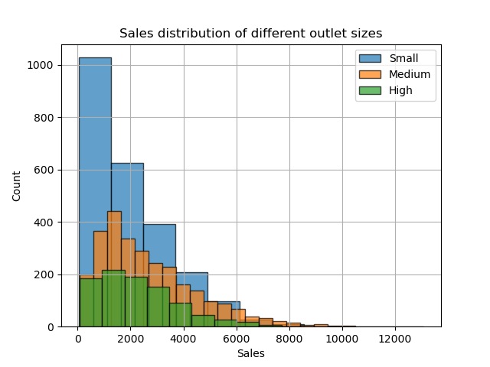
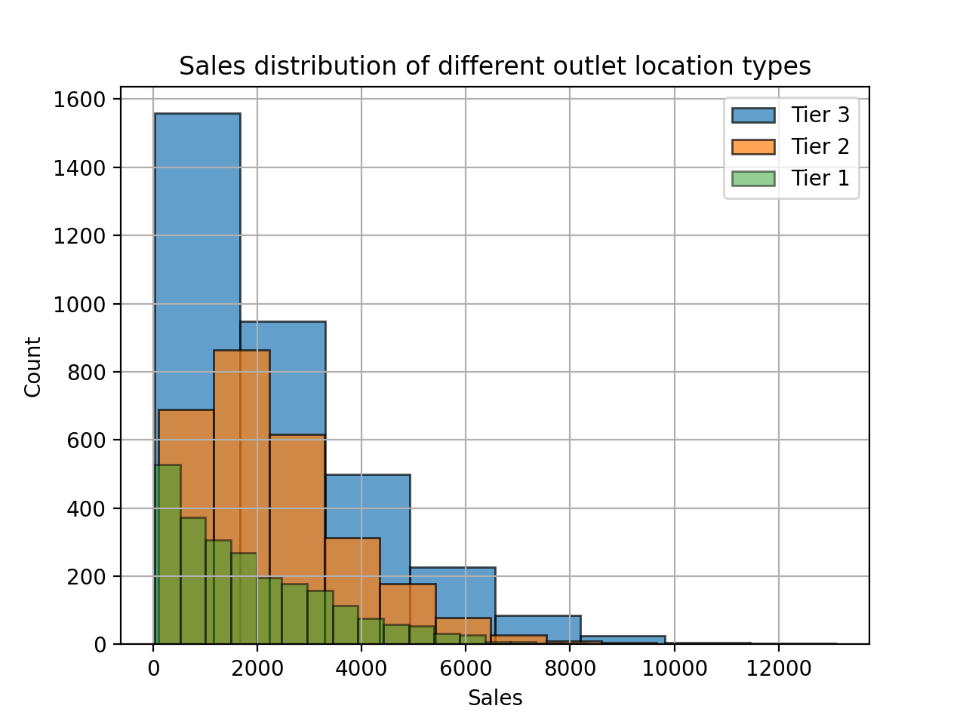
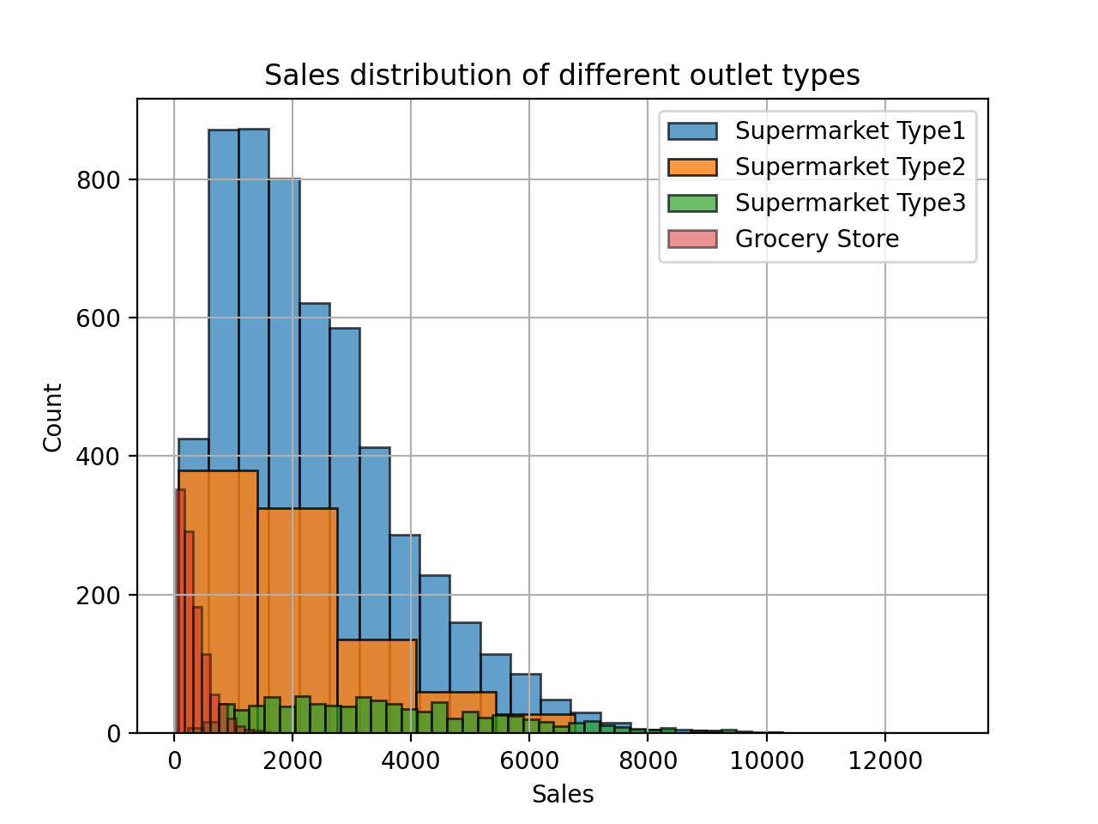
Data Clean
2. Delete outlet size - 2410 values missing - 28% of the data

Slide 5
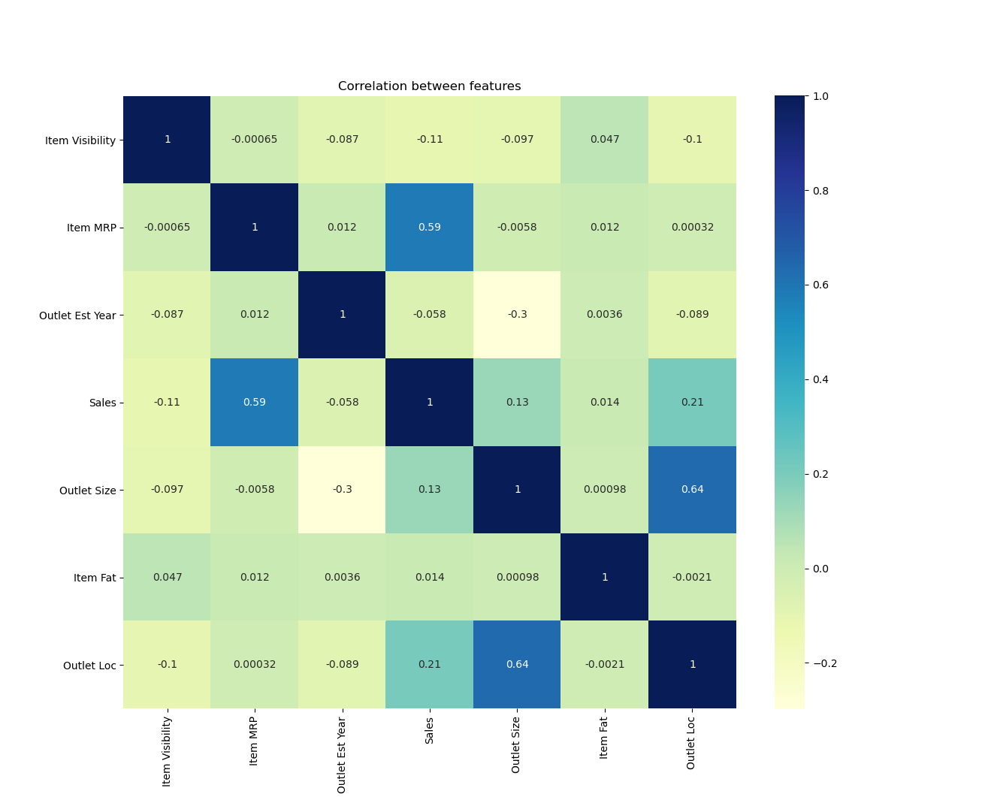
Data Clean
Features most related to sales
Item MRP (0.59)
Outlet Location Type (0.21)

Slide 6
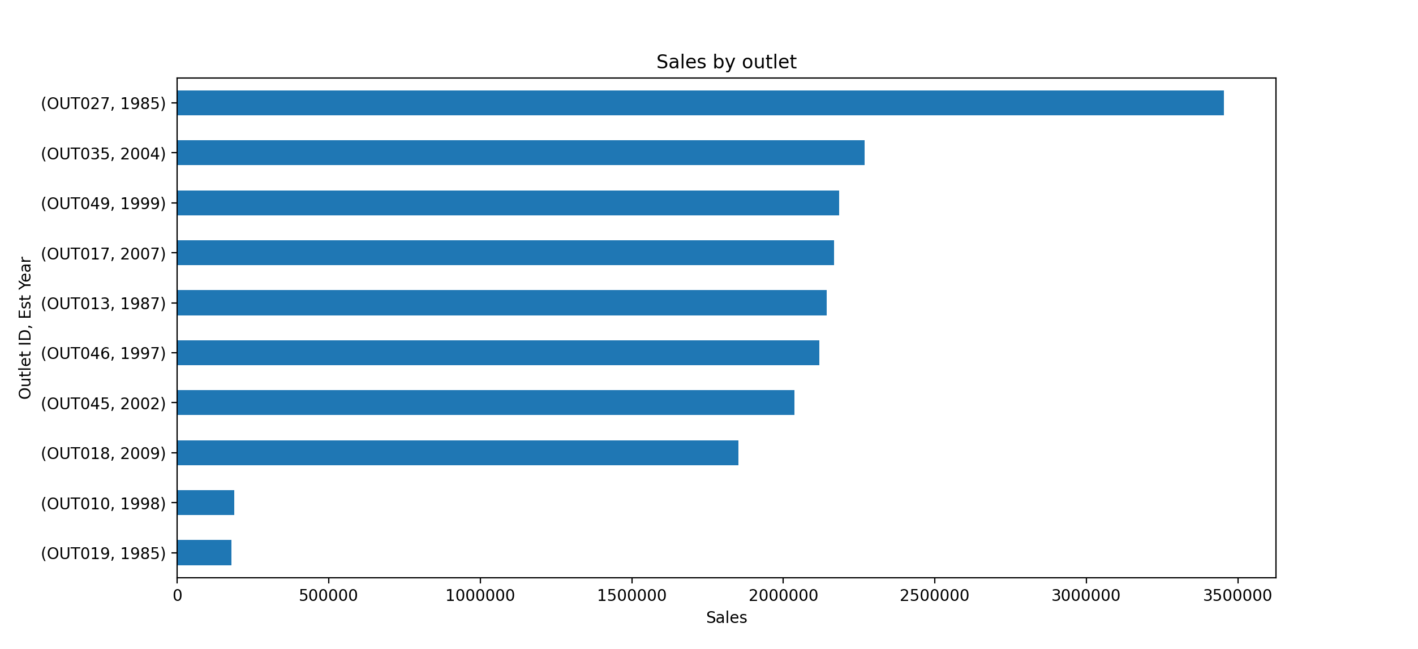
Data Clean
3. Delete outlet establishment year - less related to sales

Slide 7
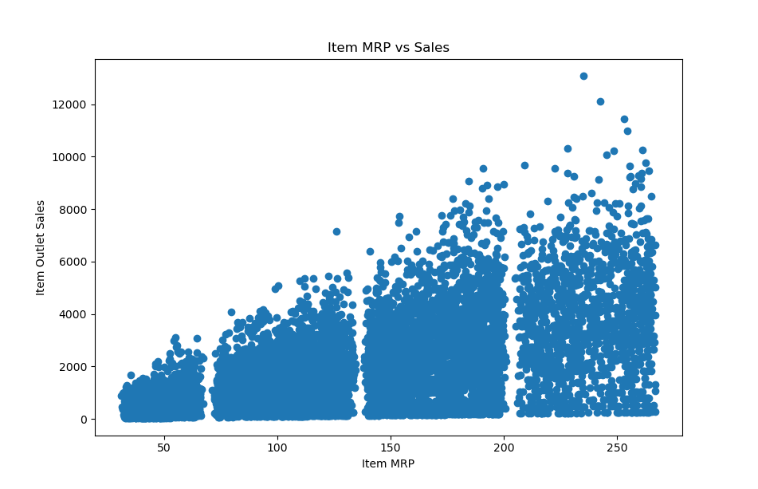
Data Visualization
Item MRP
Sales increases as item price increases

Slide 8
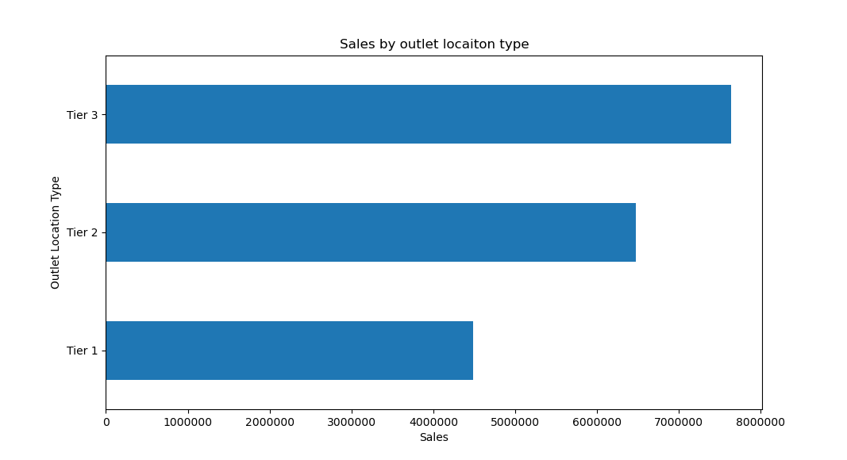
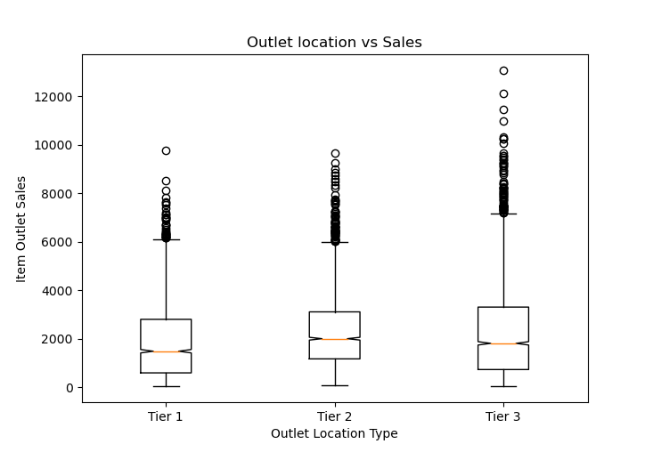
Data Visualization
Outlet Location Type - average sales similar with Tier 3 sales slightly higher

Slide 9
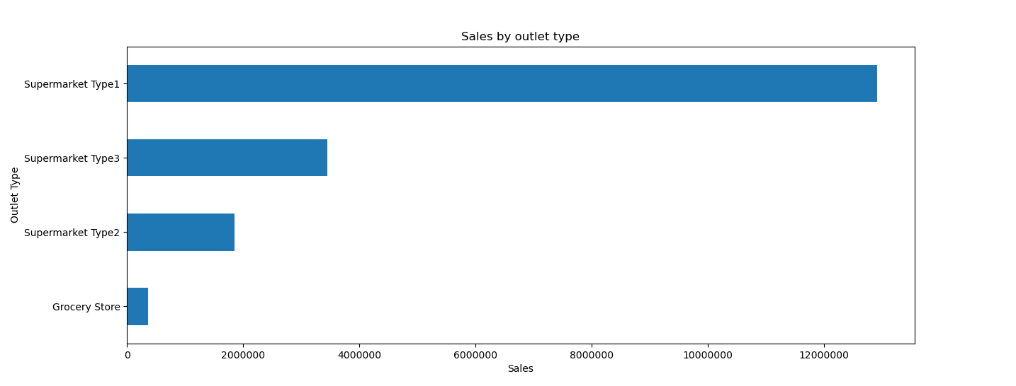
Data Visualization
Outlet Type - Supermarket Type1 has most sales

Slide 10
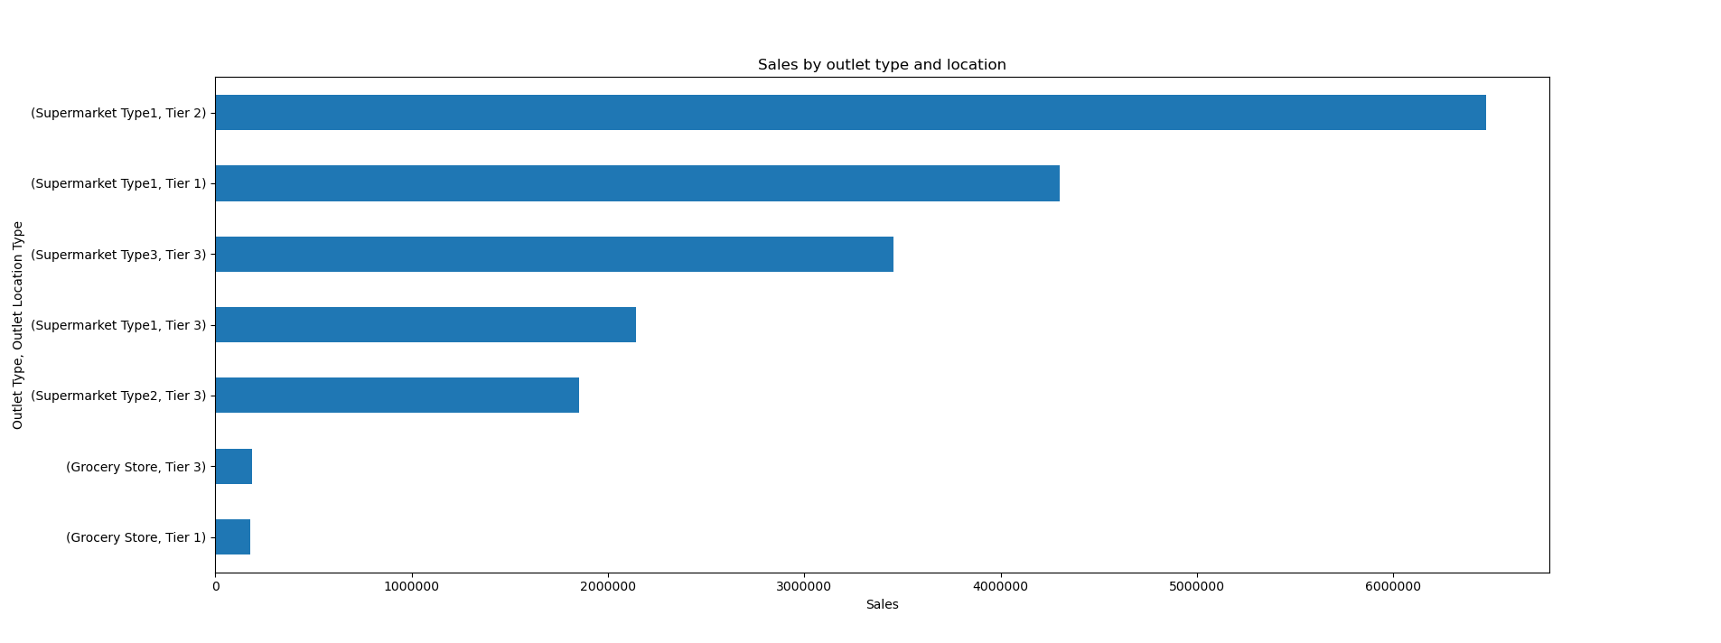
Data Visualization
Outlet Type and Outlet Location type - Supermarket Type1 & Tier 2

Slide 11
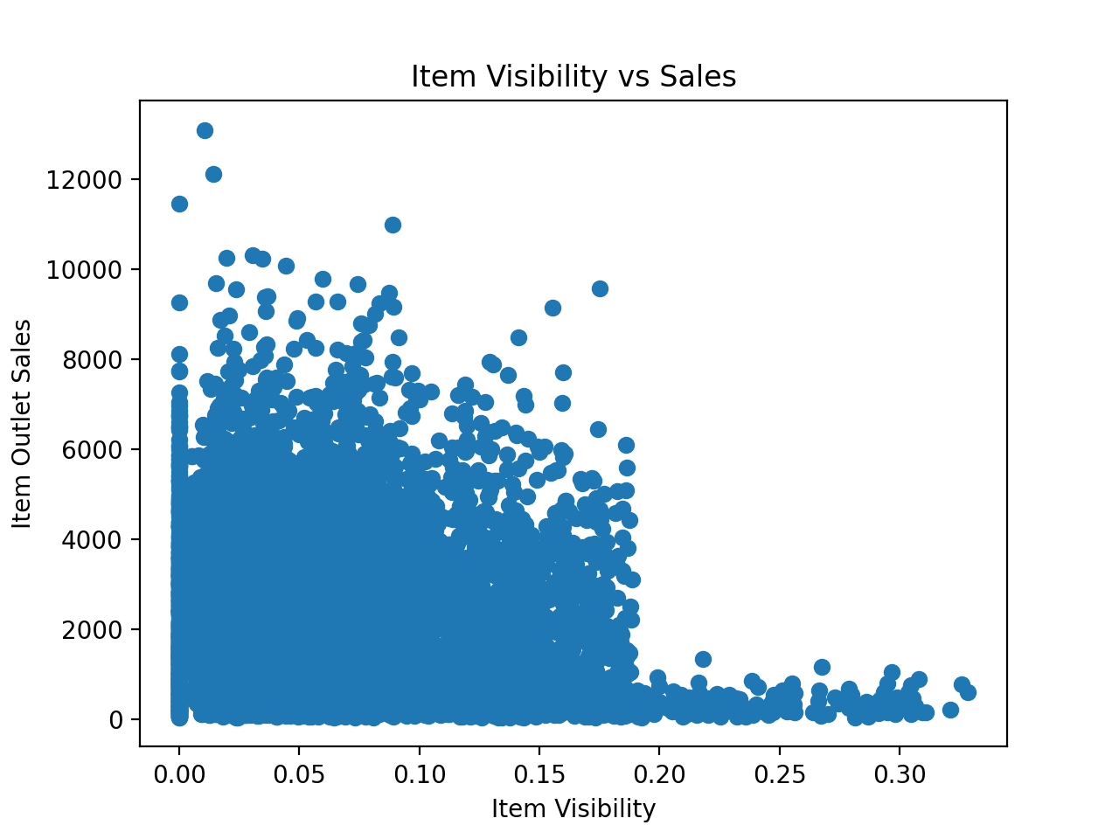
Data Visualization
Item Visibility
Lower item visibility gets more sales

Slide 12
Modeling
1. Linear Regression
Training data score - 0.55
Test data score - 0.59
RMSE - 1093

Slide 13
Modeling
2. Random Forest Regression
n_estimators = 80
Training data score - 0.93
Test data score - 0.57
RMSE - 1121

Slide 14
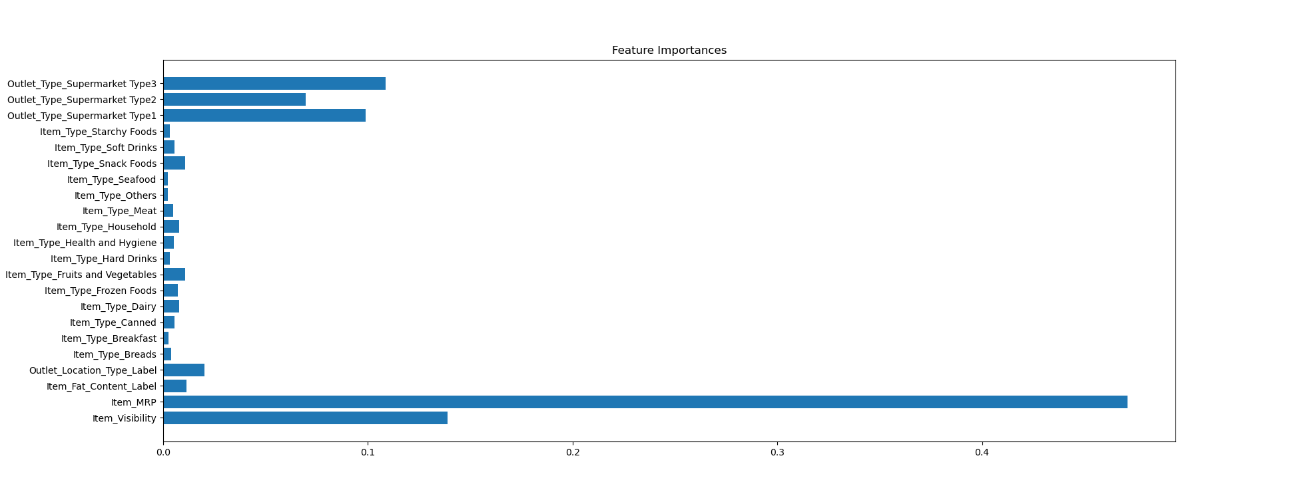
Modeling
Item MRP, Outlet Type, Item Visibility are more important - from random forest regression model

Slide 15
Modeling
3. KNN
n_neighbors = 13
Training data score - 0.58
Test data score - 0.54
RMSE - 1149

Slide 16
Conclusion and Recommendation
Final Model
Important Features
Conclusion
Linear Regression
Higher test data score - 0.59
Lower RMSE -1093
Item MRP
Outlet Location Type
Outlet Type

Slide 17
Conclusion and Recommendation
Recommendation
Sell higher price products
Build Supermarket Type1 on Tier 2 location

